Slide 1
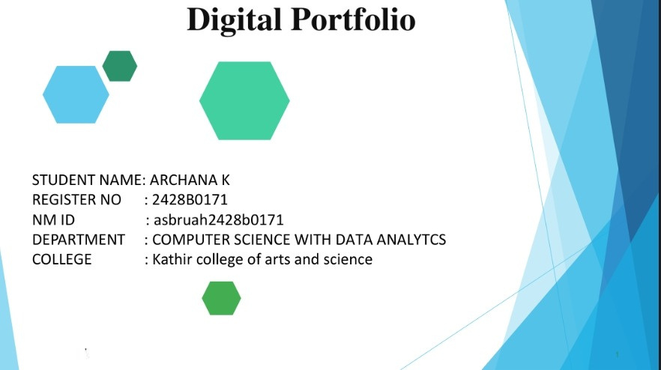

Slide 2



The Digital Challenge: Why Businesses NeedSmartTech
2

Slide 3


AGENDA
1.Problem Statement 2.Project Overview 3.End Users 4.Tools and Technologies 5.Portfolio design and Layout 6.Features and Functionality 7.Results and Screenshots 8.Conclusion 9.Github Link
3/21/2024 Annual Review
3

Slide 4



Problem Statement: The Digital Divide
In today's rapidly evolving digital landscape, businesses face immense pressure to innovate and adapt. Many struggle with outdated systems, inefficient processes, and a lack of integrated solutions, leading to lost opportunities, reduced productivity, and a disconnect with modern customer expectations. This digital divide hinders growth and competitive advantage
4

Slide 5


Project Overview:bridging The Gap
This project aims to develop a comprehensive, scalable digital solution designed to streamline operations, enhance user experience, and drive measurable growth for modern businesses. We focus on creating intuitive, powerful tools that integrate seamlessly into existing workflows
5

Slide 6

End Users:empowering Diverse Stakeholders
Sour solutioncatersto a broadspectrumofend-users, each with unique needs and objectives:
1) Executives gain high-level insights, track kpis, and make
data- driven strategic decisions.
2)Sales&marketingautomatecampaigns,manageleads,
and analyze market trends for targeted outreach. 3) Customer service teams access comprehensive customer data for personalized and efficient support.
4) Operations staff streamline workflows, manage inventory, and optimize resource allocation
6

Slide 7
TOOLS AND TECHNOLOGY:OUR
FOUNDATION
Tools &Technology: OurFoundation
Our robust solution is built upon a modern, reliable, and scalable technology stack:
1 Front-End React.js, HTML5, CSS3, JavaScript. Ensuring a dynamic
and responsive user interface. 2Back-End Node.js, Python/Django, RESTful APIs. For powerful server-side logic and data handling. 3Database PostgreSQL, MongoDB. Secure and efficient data storage
solutions.
4Cloud Infrastructure AWS, Docker, Kubernetes. For scalable deploymen
7

Slide 8




Potfolio Design And Layout
Ourportfoliodesign focusesonclarity,user-friendliness, and aesthetic appeal. Each component is meticulously crafted to ensure seamless navigation and a consistent brand experience across all platforms. We prioritize responsive layouts that adapt to any device
8

Slide 9
Key Features And Functionality
❖
Automated Workflows Reduce manual tasks and improve
efficiency with intelligent
automationforroutineprocesses.
❖
Integrated CRM Centralize customer data for enhanced
relationship management and personalized communication.
❖
Real-time Analytics Dashboard Visualize critical business
metrics with customizable dashboards for immediate insights.
❖
Scalable Modules Adapt the solution to your evolving business
needs with modular, expandable components

Slide 10




Results And Screenshots:impact AndAction
3/21/2024 Annual Rview
10

Slide 11
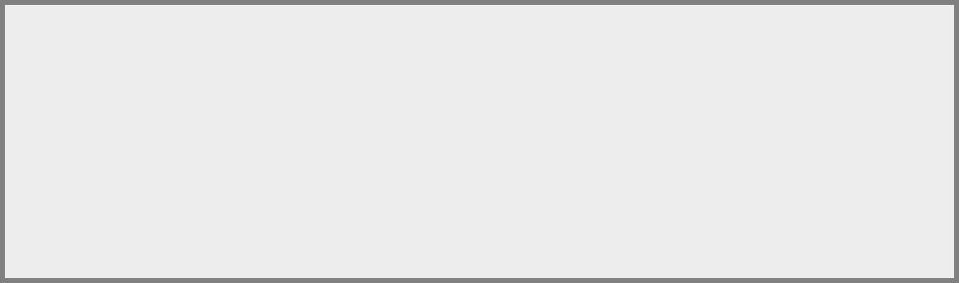

Conclusion
Conclusion & NextStepsOursmarttechsolution is poised to
revolutionize how businesses operate, fostering efficiency, growth, and adaptability in the digital age. We invite you to explore its full potential
11

